Slide 1
Migration in the EU: challenges and opportunities/EUMig
Natalia Zhurbina
Voronezh State University

Slide 2
3 main points
Basic information about the project.
Project aims.
The events held within the framework of the project.

Slide 3
Project website: http://euspace.vsu.ru/en/eumig

Slide 4


Faculties-participants
Faculty of International Relations
Faculty of Philosophy and Psychology

Slide 5
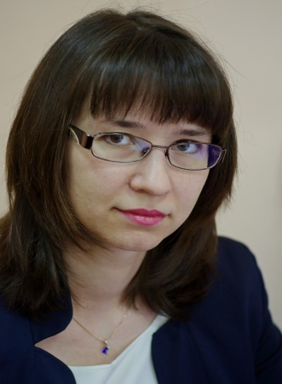
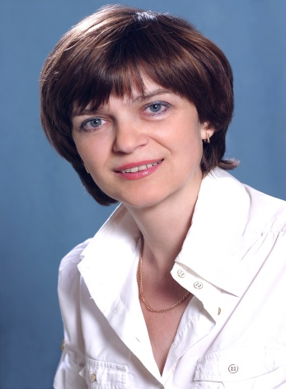
Project staff
Natalia Zhurbina
International Relation Faculty
Elena Yakushkina
Philosophy and Psychology Faculty

Slide 6
The target groups
Students
Local authorities

Slide 7
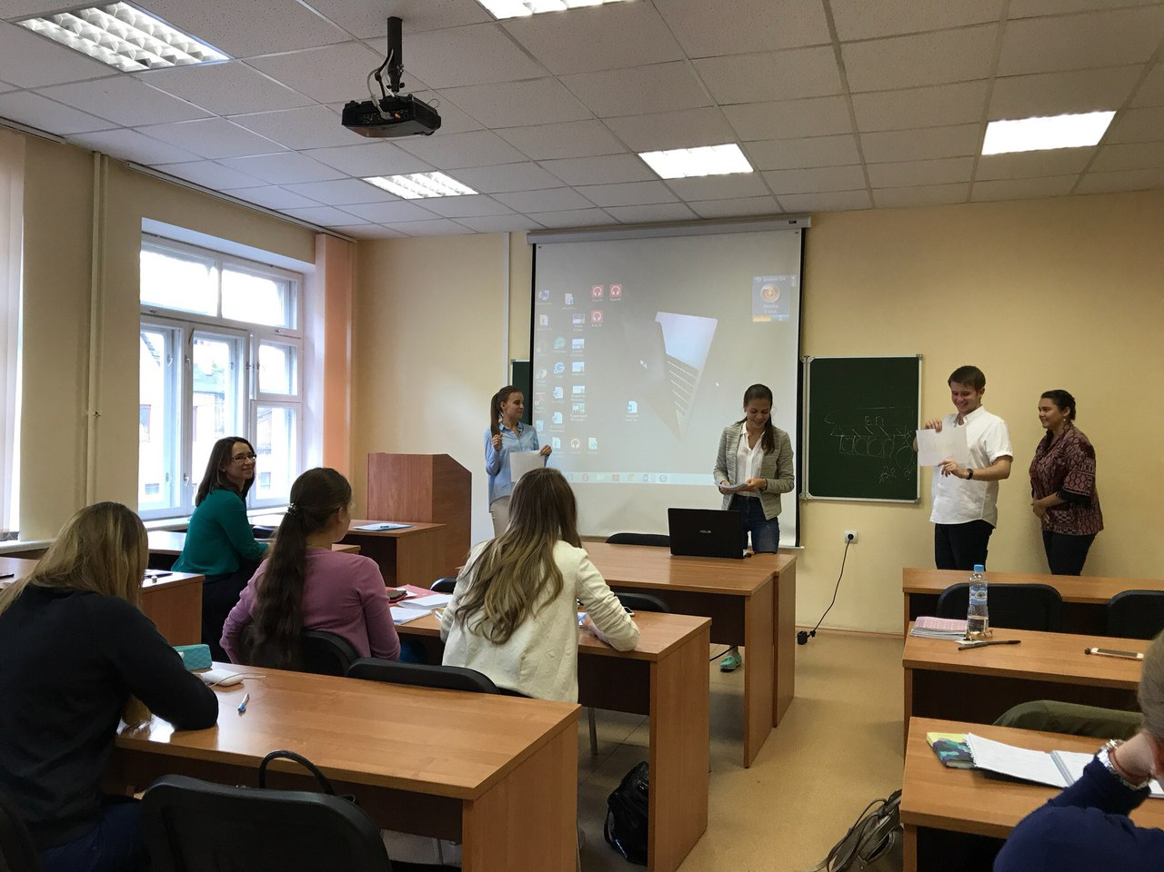
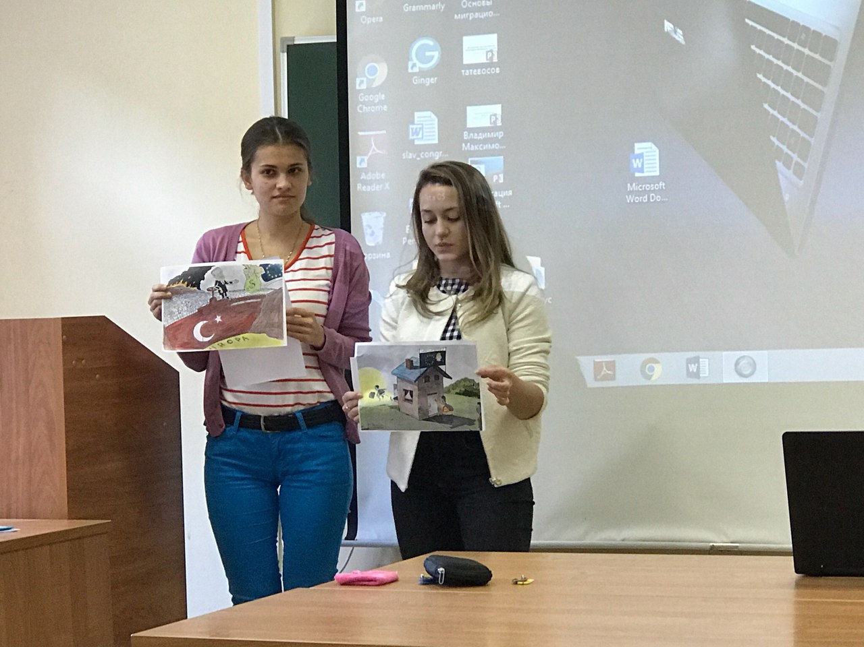
The main module discipline
“Migration in the EU”

Slide 8
The strategic aims
to increase interest in understanding and involvement with the European Union
to draw the student's attention to migrations problems in the EU
to form comprehensive approach to migrations problems

Slide 9
Project aims
to reinforce the European studies in the syllabus of two mentioned faculties;
to form the complex approach to migration studies including socio-economic sphere, intercultural communication and gender aspects;
to attract the attention of students, pupils and public organizations to the project issues.

Slide 10
to reinforce the European studies in the syllabus of two mentioned faculties
the teaching load for the main module discipline increased twice (from 2 credits to 4 credits);
new discipline “Socio-cultural aspects of migration” for bachelor degree students included in the syllabus of the Philosophy and Psychology Faculty;
new discipline “Migration problems in Europe” for master degree students included in the syllabus of International Relations Faculty.

Slide 11
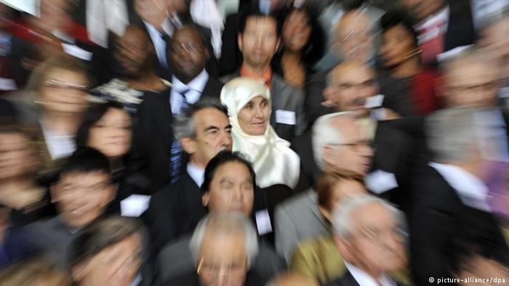
To form the complex approach to migration studies including socio-economic sphere, intercultural communication and gender aspects

Slide 12
Faculty | Year | Subjects
Bachelor’s Degree Program
Philosophy and Psychology Faculty | 2 | Female and male behavior stereotypes
 | 3 | Gender aspects of everyday culture
 | 3 | Intercultural communication
 | 4 | Social and cultural aspects of migration
Faculty of International Relations | 1 | World religions
 | 2 | Cultural and civilizational models
 | 4 | Intercultural communication
 | 4 | Migration to the EU
Master’s Degree Program
 | 1 | European migration problems

Slide 13
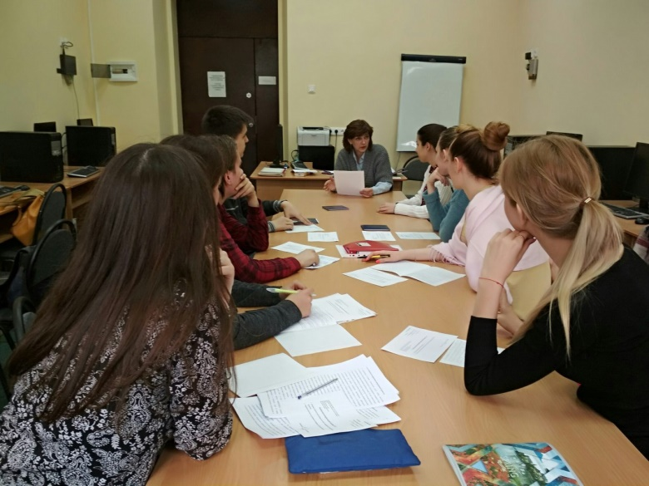
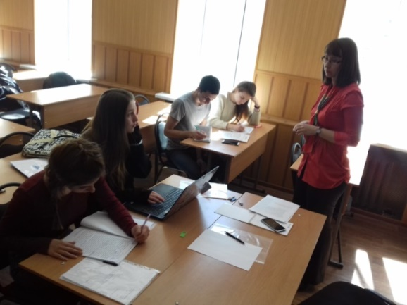
Module objective: to stimulate students’ scientific research on migration problems
18 students have written their final research papers on this topic;
4 articles and 2 student’s books published.

Slide 14
Events within the framework of the module
Lectures for employees of the Office of Investment Promotion
International Students UN-Model
Round table discussion of Russian students with the students from Goettingen University of the problems of forced migration from Syria

Slide 15
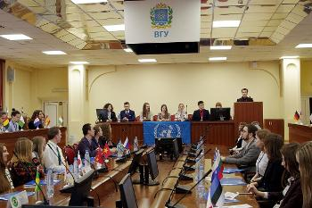
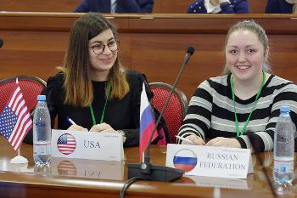
VI International Students UN-Model

Slide 16
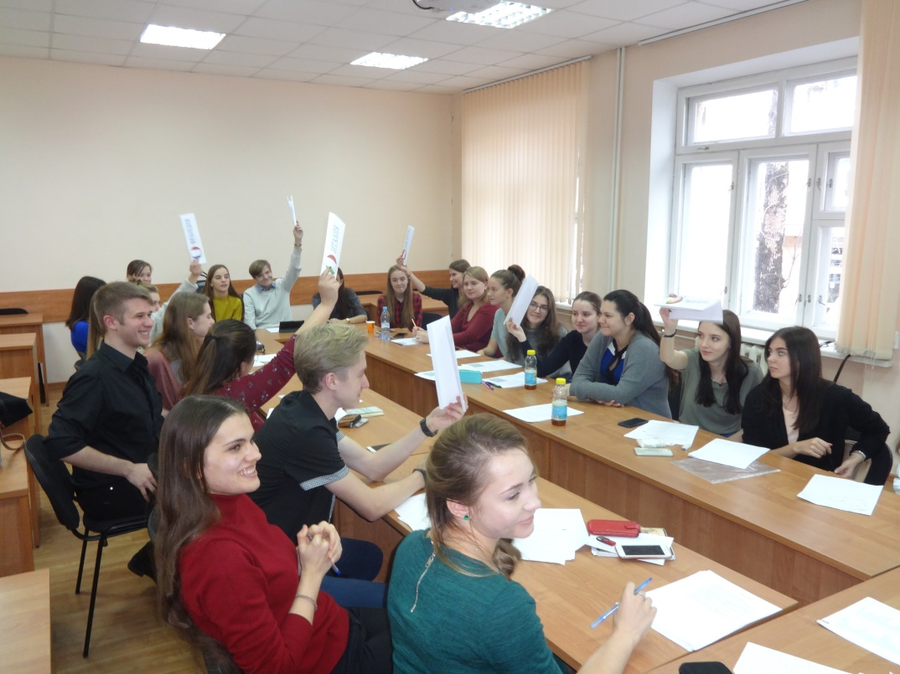
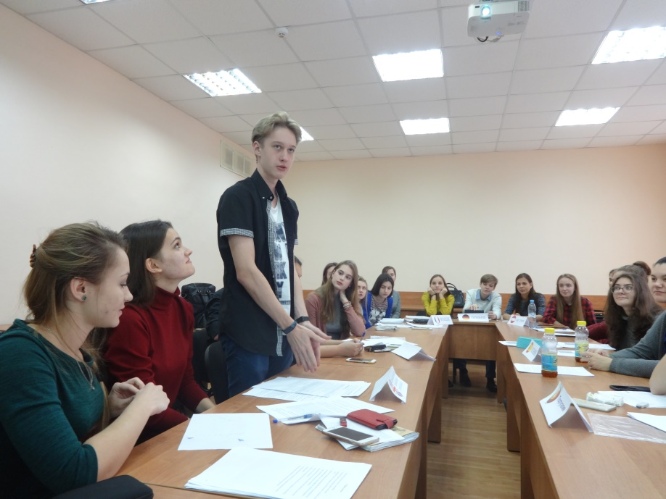
Council of Europe Model for VSU students and pupils of Voronezh schools

Slide 17
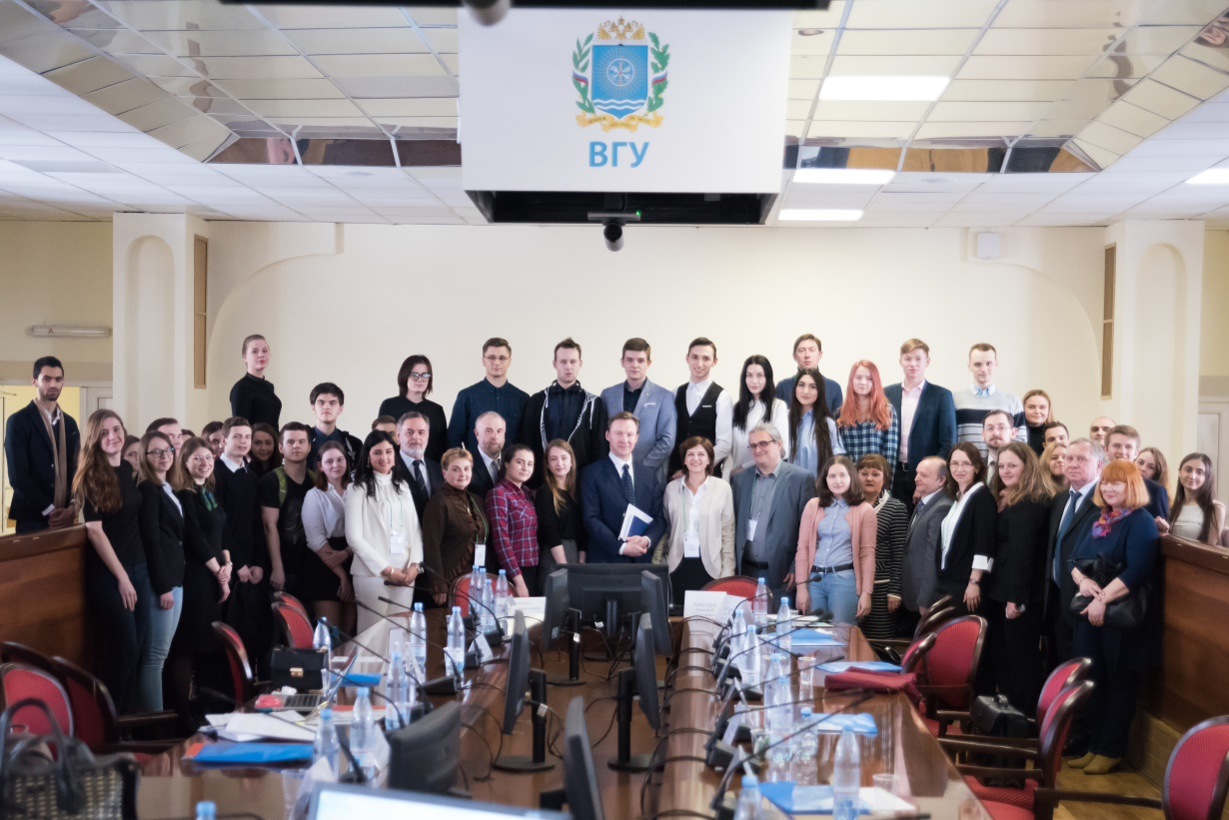
International conference “Europe in the 21st century: new challenges and opportunities”

Slide 18
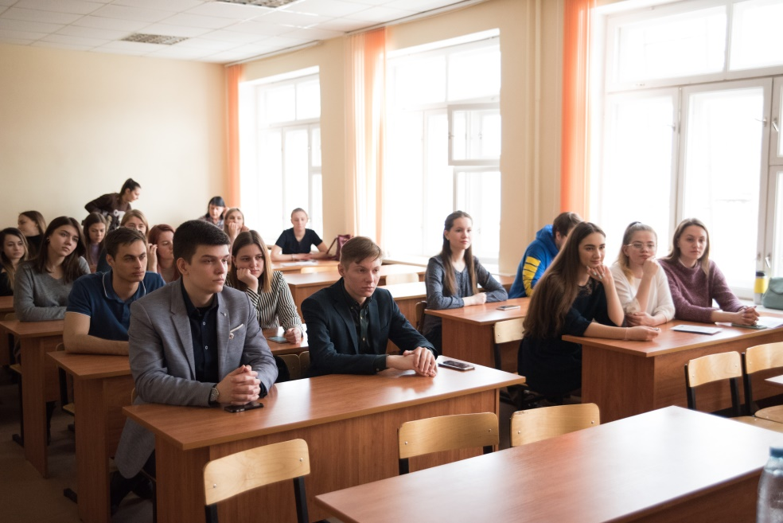
Conference
Workshops
Discussions
Lectures

Slide 19
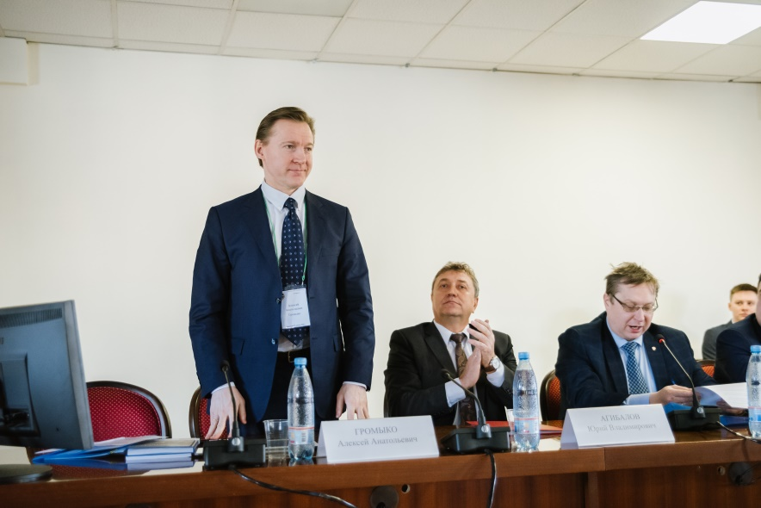
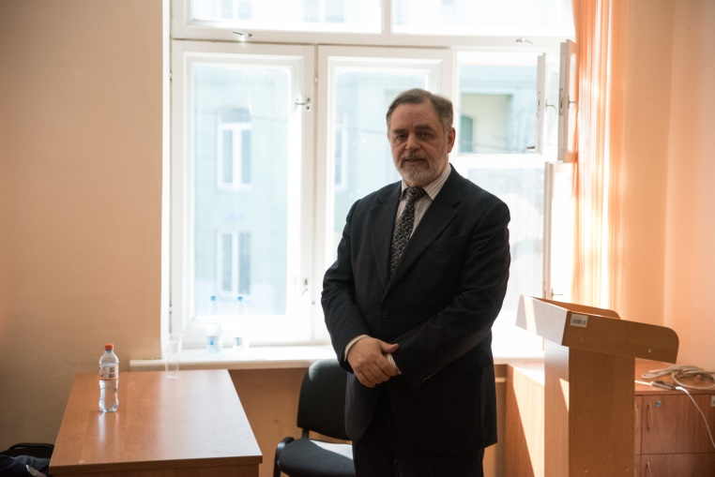
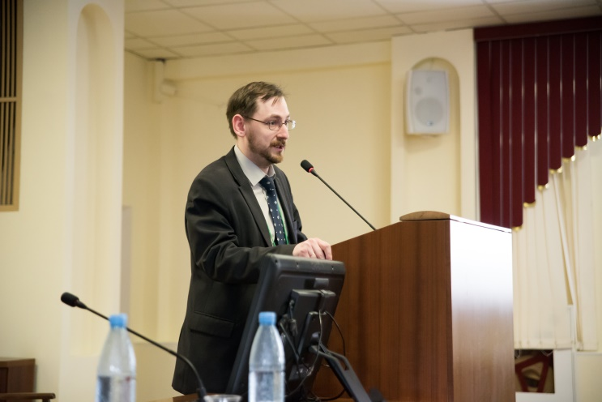
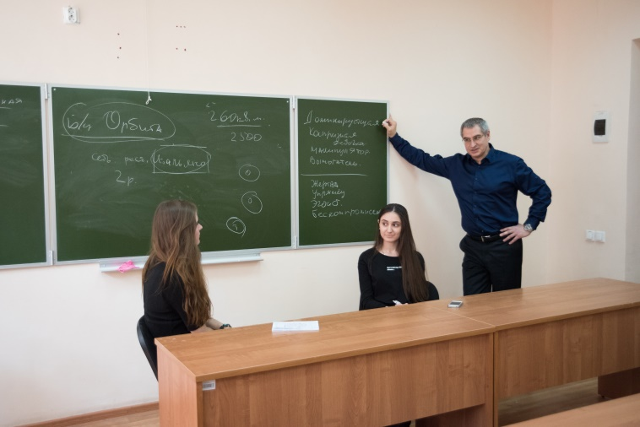
Speakers from Russian research institutes

Slide 20
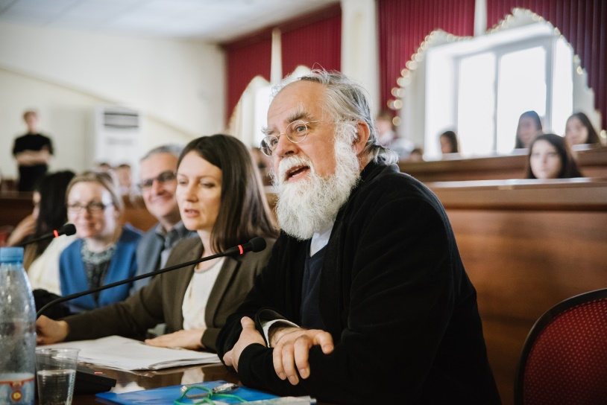
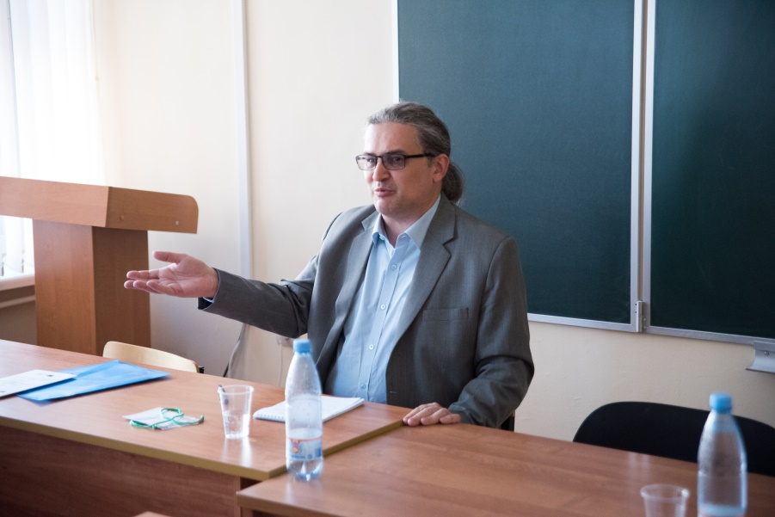
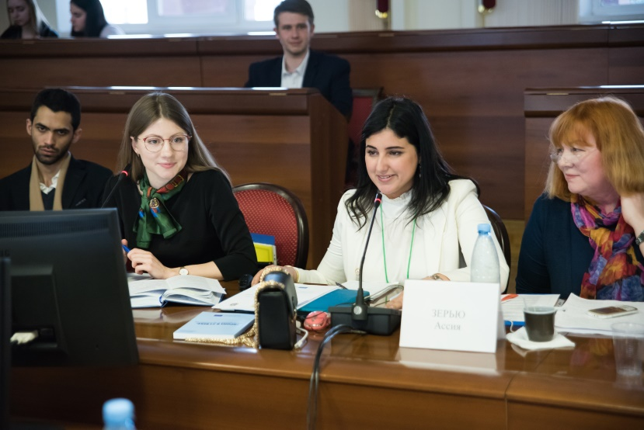
Foreign experts
Germany
Austria
Morocco

Slide 21
Contacts
Natalia Zhurbina
Faculty of International Relations
Department of Regional Studies and National Economies
Email: zhurbina@ir.vsu.ru

Slide 22
Thank you for attention!

