Slide 1
Migration in the EU: challenges and opportunities/EUMig
Natalia Zhurbina
Elena Yakushkina
Department of Regional Studies
and National Economies
Faculty of International Relations

Slide 2
Faculties- participants
Faculty of International Relations
Faculty of Philosophy and Psychology

Slide 3
The project is targeted at
Students
Regional and local authorities

Slide 4
The strategic aims
to increase interest in understanding and involvement with the European Union
To draw the student's attention to migrations problems in the EU
to form comprehensive approach to migrations problems

Slide 5
Project objectives
 | Objectives | Interim results
1 | Implementation of new disciplines and providing the staff with job opportunities | The new discipline «Sociocultural migration aspects» is introduced at the Faculty of Philosophy and Psychology During 2017-2018 the new discipline in terms of the two JM units: EUMig and SHEXP - «Economic and sociocultural migration aspects” is introduced at the Faculty of International Relations

Slide 6
The structure of the educational module
Faculty | Year | Subjects
Baccalaureate Programme
PPF (Philisophy and Psychology Faculty) | 2 | Female and male behavior stereotypes
 | 3 | Gender aspects of everyday culture
 | 3 | Intercultural communication
 | 4 | Social and cultural aspects of migration
FoIR (Faculty of International Relations) | 1 | World religions
 | 2 | Cultural and civilizational models
 | 4 | Intercultural communication
 | 4 | Migration to the EU
Master’s Degree Programme
 | 1 | European migration problems

Slide 7
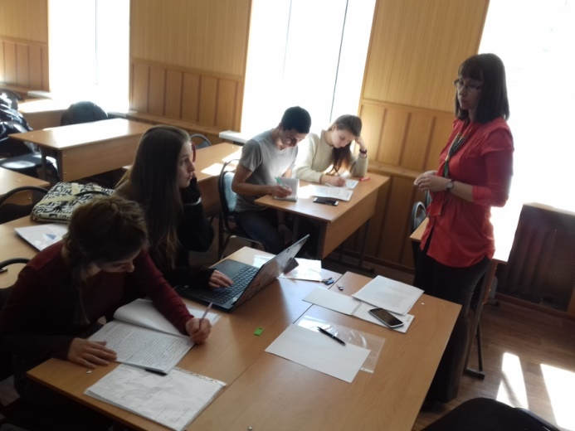
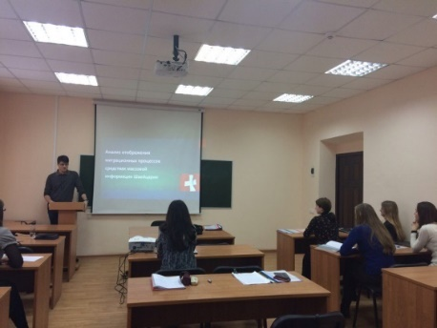
Objectives of the module
 | Objective | Interim result
2 | Enhancing students’ scientific research into the project issues | 11 people doing degree research work on the project issues 2 articles on the module topic have been published: Cultural Adaptation of Migrants in Russia in the Context of European Migrant Crisis Government Regulation and Sociocultural Practices of Migrants’ Adaptation (Voronezh Region as an example)

Slide 8
Module Targets
 | Target | Interim Result
3 | Efficient interaction between module disciplines | Second International Student UN Model Assembly (devoted to the international migration issues); Round table with students from Georg August University (Göttingen, Germany).

Slide 9
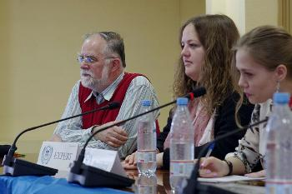
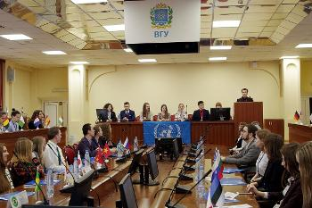
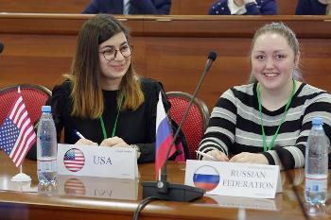
VI International Student UN model
The second Student General Assembly on international migration problems

Slide 10
Thank you for attention!

